Slide 1
Hepatite autoimune e doença hepática esteatótica
John Hart, MD
Universidade de Chicago, EUA

Slide 2
Declaração de Conflito de Interesse
Dr Hart afirma não ter conflito de interesse a declarar
Em caso afirmativo, especificar: associação financeira relevante
nos últimos 12 meses e que esteja relacionada ao conteúdo da
atividade científica
Exigência da RDC Nº 96/08 da ANVISA

Slide 3
Two Co-existent Diseases
Patients with AIH can have risk factors for NASH and/or consume alcohol and therfore can have steatohepatitis
Patients with steatohepatitis are at NO increased risk for AIH but can have positive serum autoantibodies
VERSUS

Slide 4

Clinical History
24-13699
36 year old obese female (BMI = 38) with Hashimoto’s thyroiditis and type 2 diabetes
Presents with fatigue and abdominal pain
TB = 1.0, AST = 468, ALT = 391, alk phos = 122
HAV, HBV, HCV, negative
ANA 1:160, anti-SMA = 47; AMA negative
Medications: glyburide, metformin, losartan, thyroxine

Slide 5
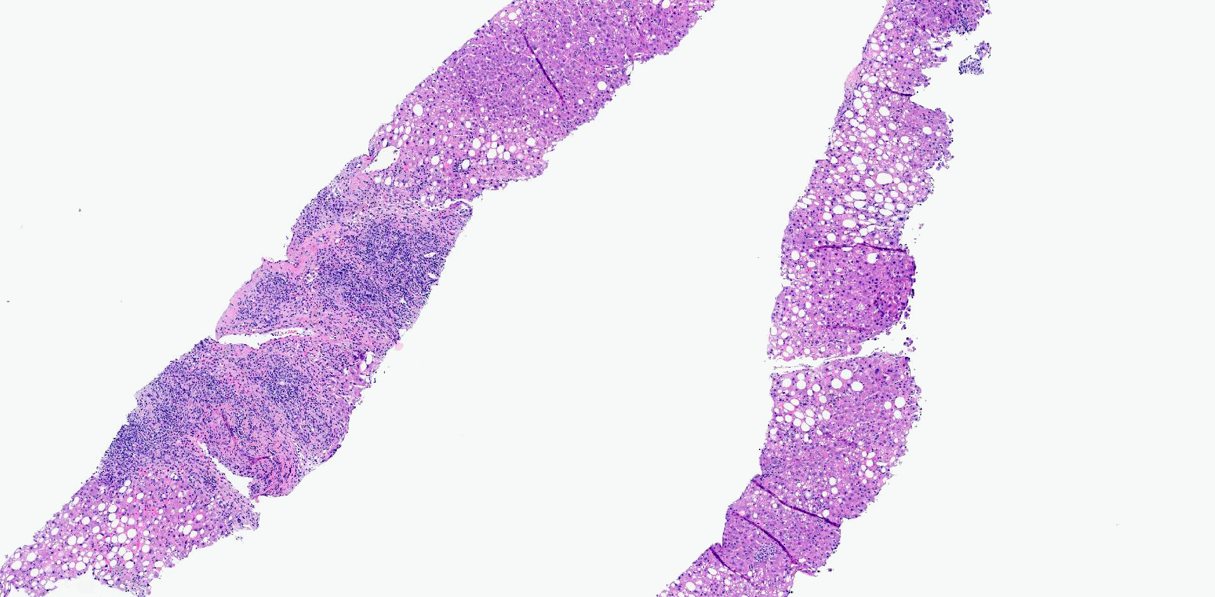

Slide 6
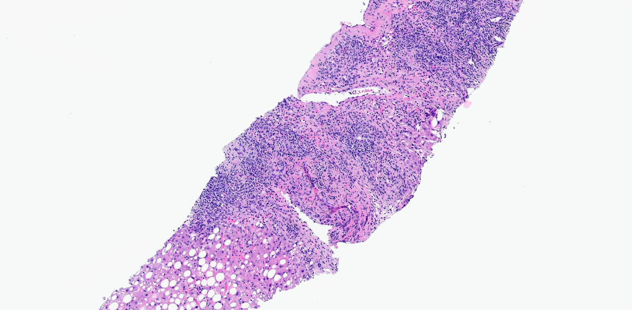

Slide 7
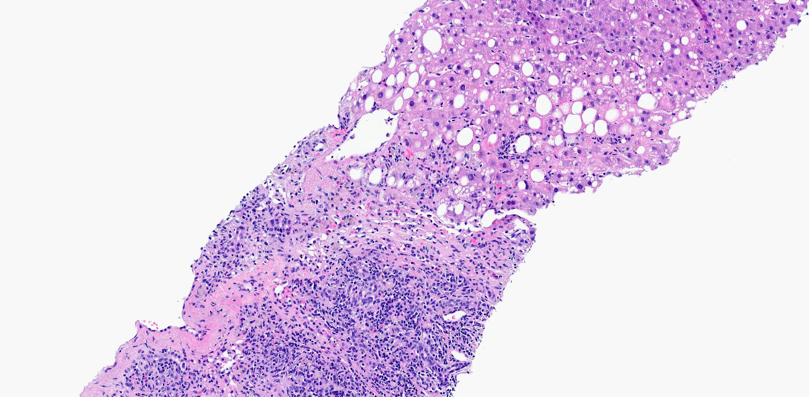

Slide 8
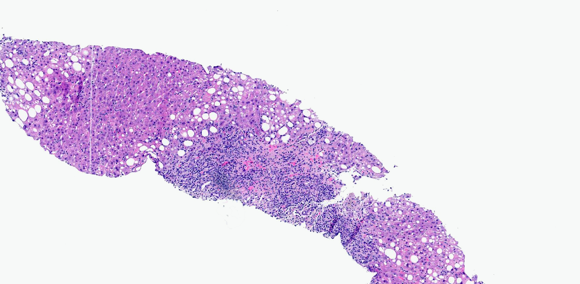
Autoimmune hepatitis (grade 2, stage 0)

Slide 9
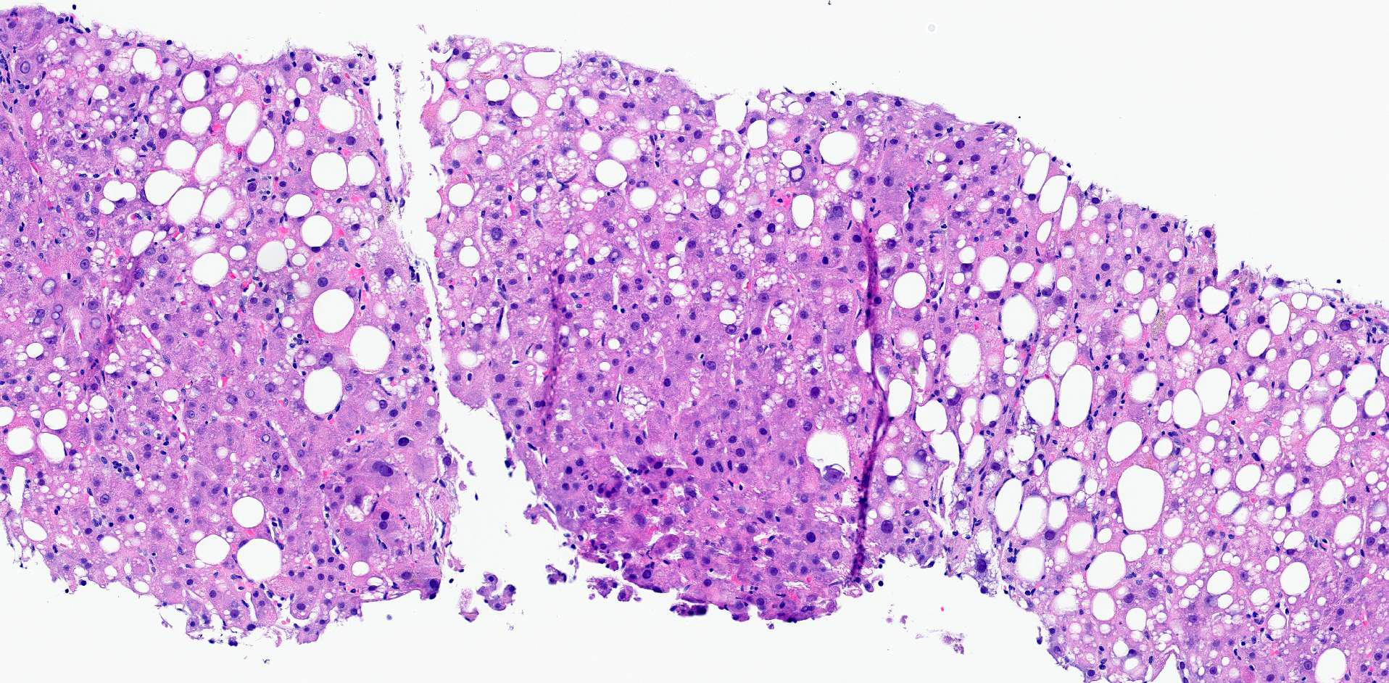
Steatohepatitis (grade 1, stage 1)

Slide 14
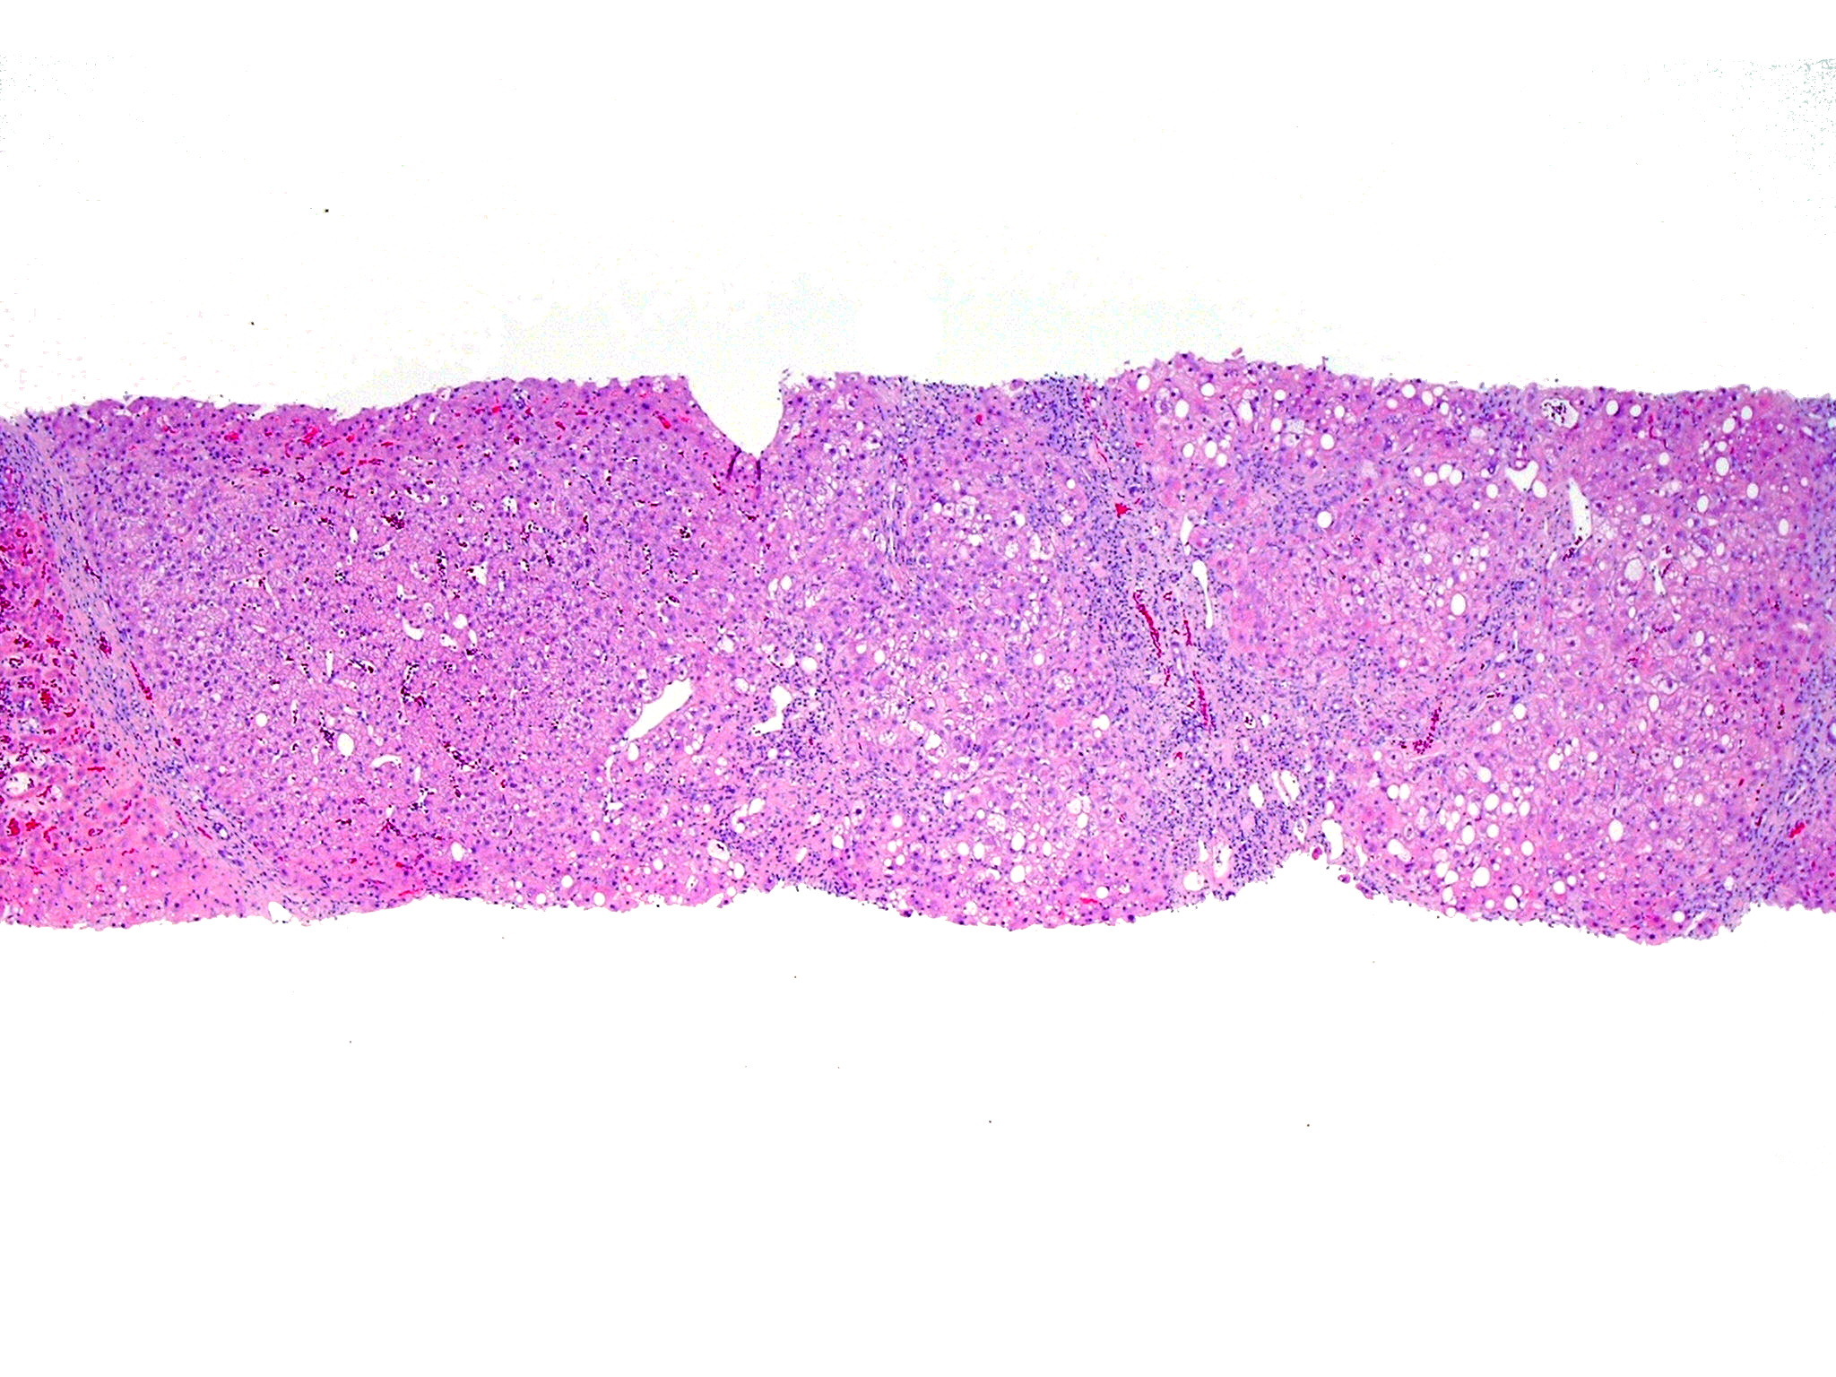
Notes:
Advanced fibrosis most import feature for portal inflammation

Slide 15
Notes:
NIT = Non-Invasive Tests

Slide 16
ANA positivity is more common in NAFLD patients that UNDERGO BIOPSY

Slide 18
Clinical History
11-12809
13-28786
45 y.o. F s/p bilateral mastectomy for breast cancer
Currently on Tamoxifen
Obese; social drinker; type 2 diabetes mellitus
TB = 0.7, AST = 102, ALT = 117, alk phos = 62
Albumin = 4.7, PLT = 350K,
HAV, HBV, HCV negative
ANA = 1:160; anti-SMA = < 1:25
Heterozygous H63D; C282Y not detected
Ceruloplasmin = 24.8, alpha-1-antitrypsin PiMM

Slide 19
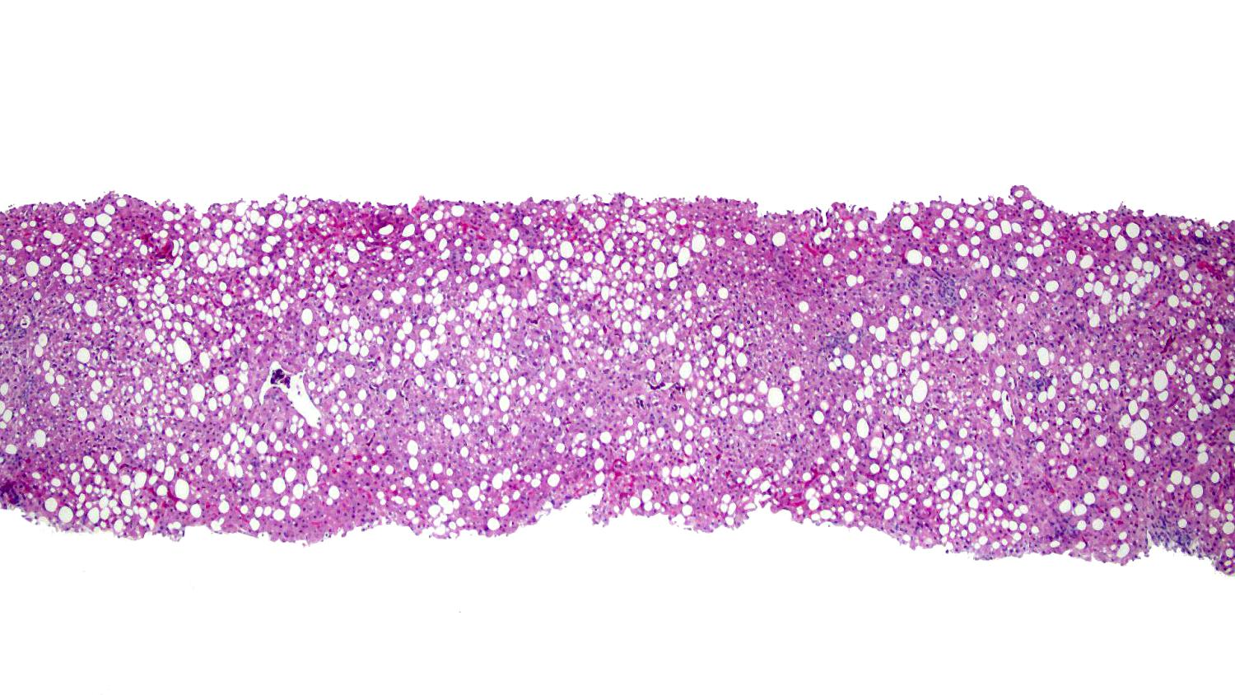

Slide 20
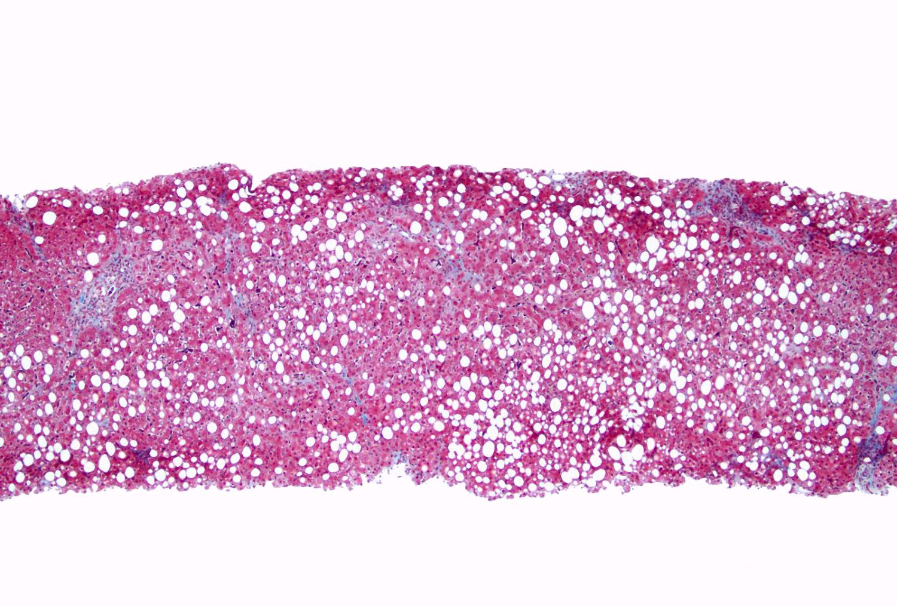
trichrome stain

Slide 21
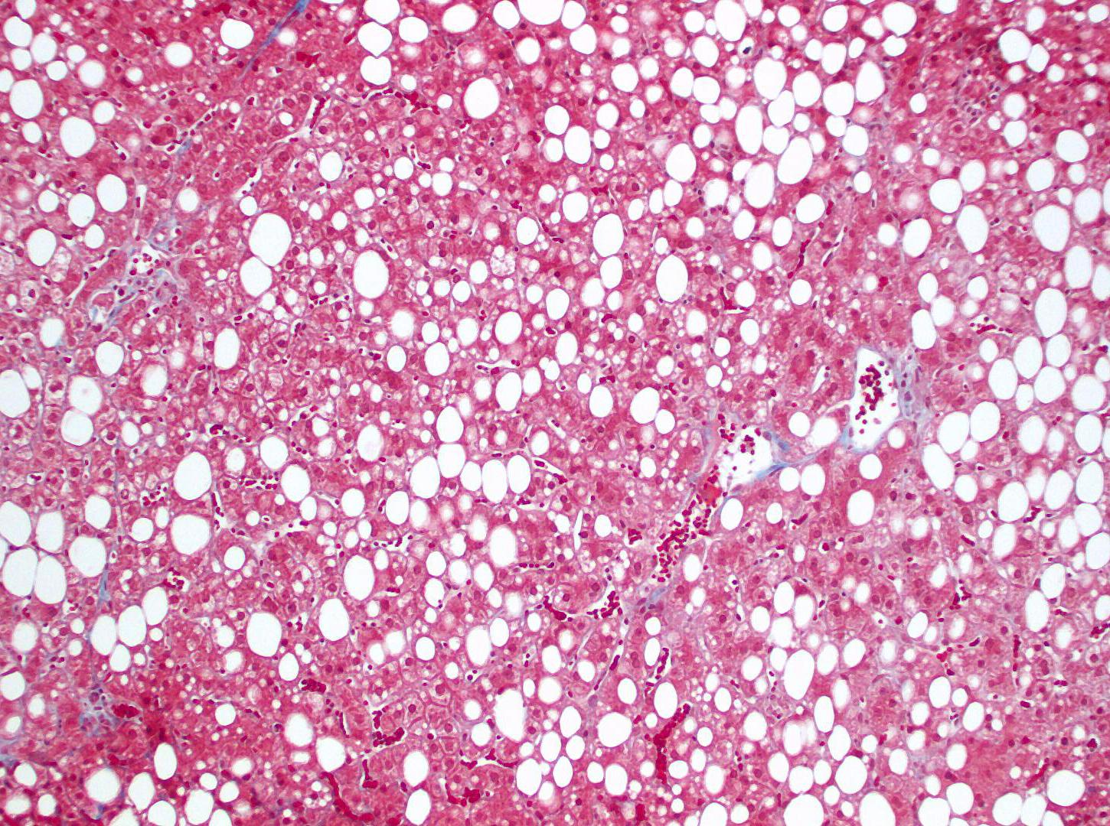
trichrome stain

Slide 22
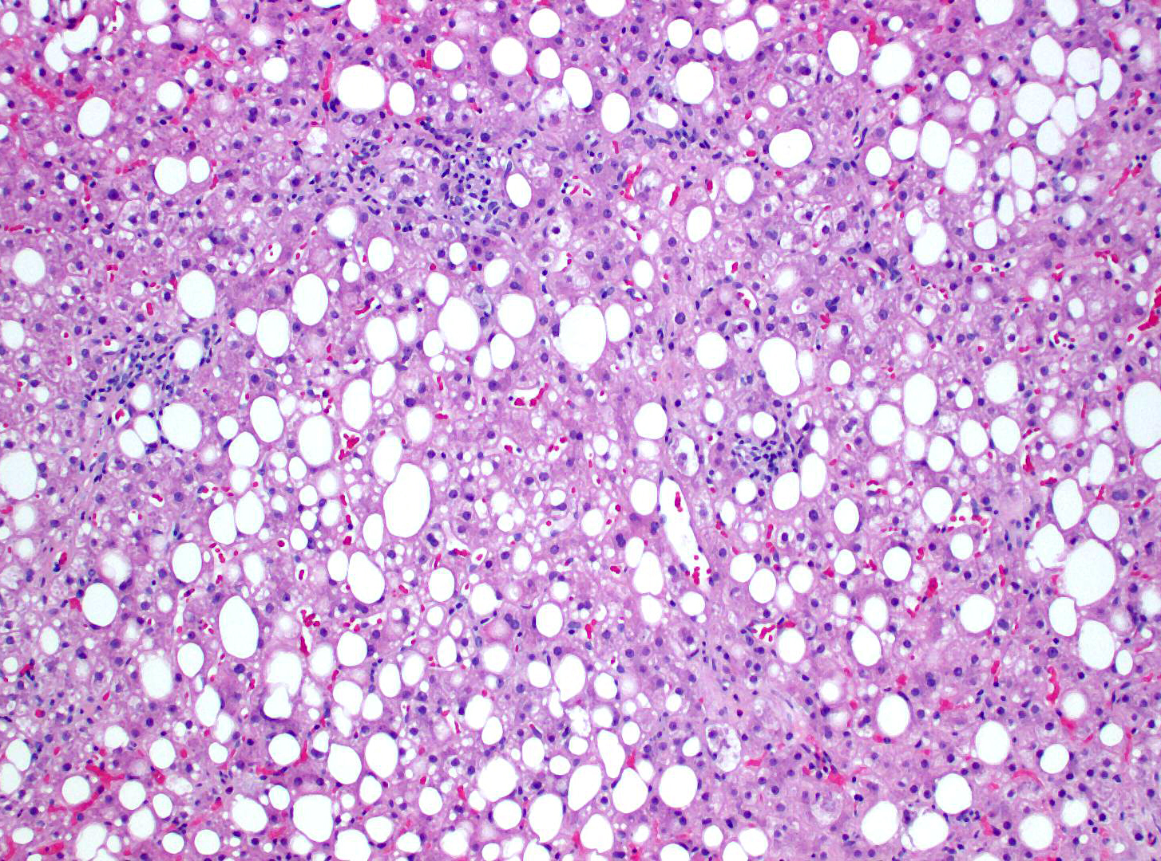

Slide 23
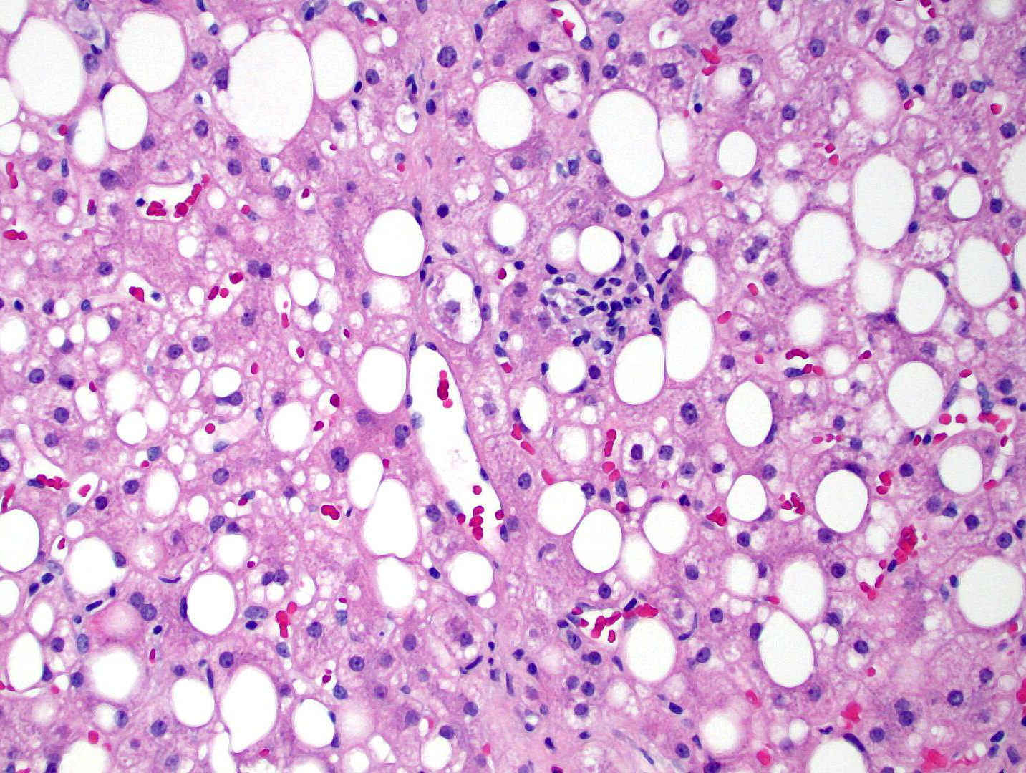

Slide 24
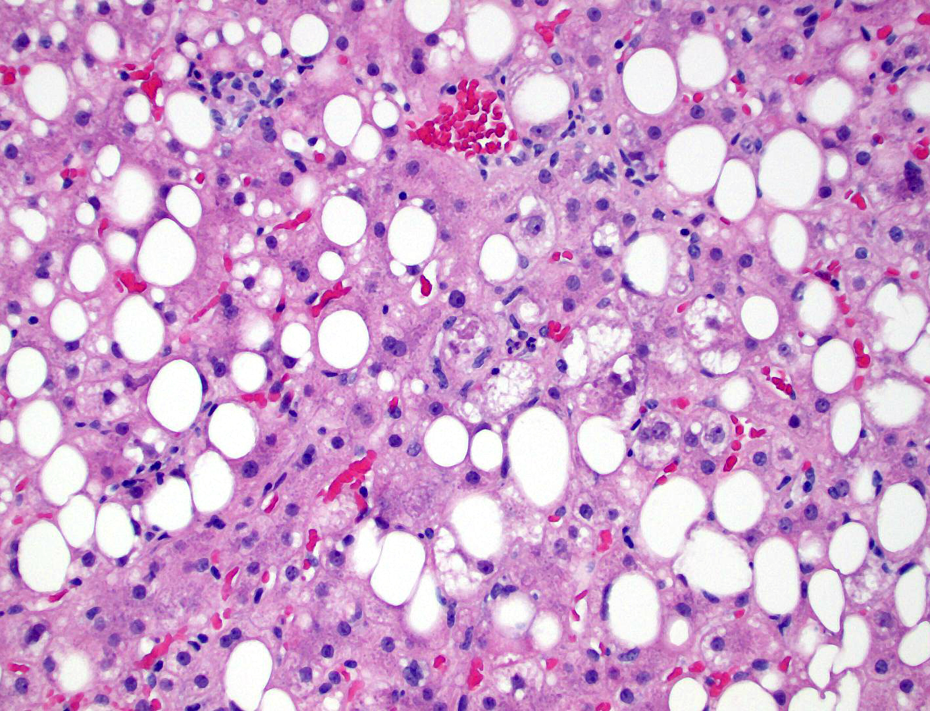
Grade 2, Stage 1 steatohepatitis
No evidence of autoimmune hepatitis

Slide 25
Clinical Follow-up
Seen again two years later
Still on Tamoxifen (until 2016)
TB = 0.7, AST = 113, ALT = 79, alk phos = 73
Hyperlipidemia, obesity, type 2 DM (metformin)
PE reveals mild hepatomegaly
U/S reveals fatty liver disease
FIBROSPECT = 89
Repeat liver bx – progression to stage 2

Slide 26
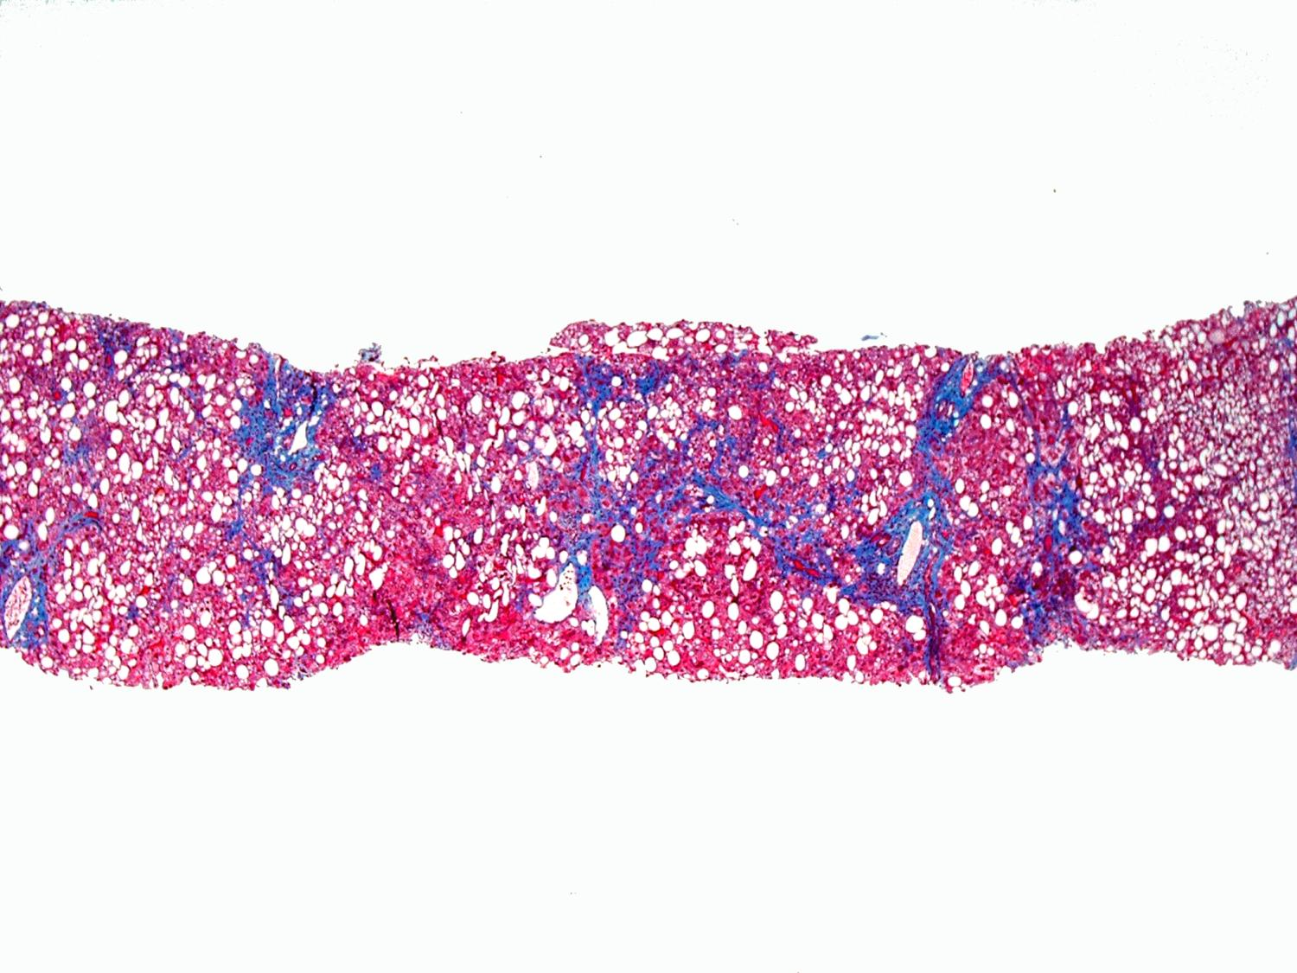
trichrome stain

Slide 27
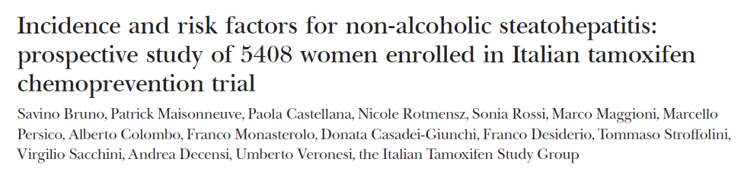
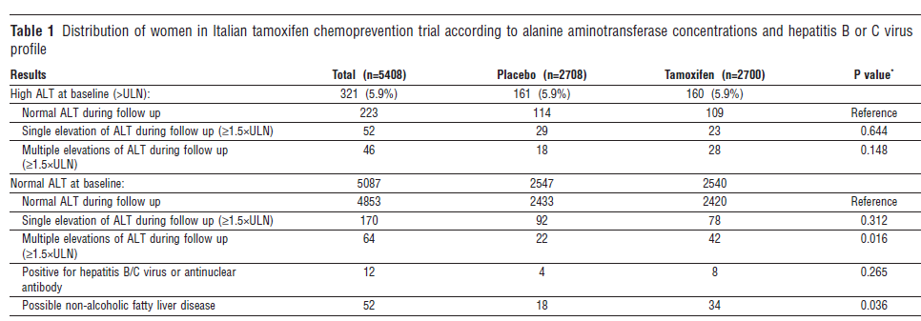
BMJ, doi:10.1136/bmj.38391.663287.E0 (published 21 March 2005)

Slide 28
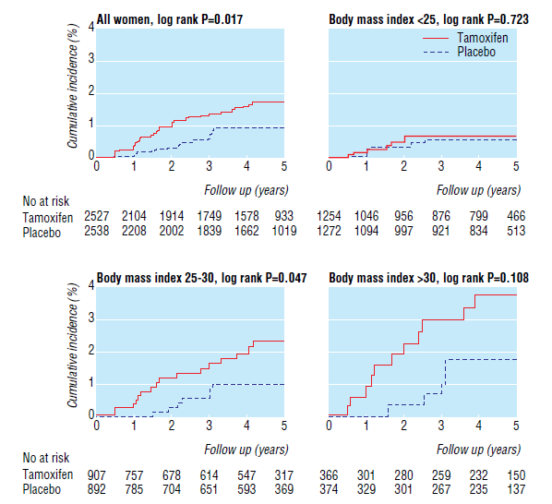

Slide 30
Autoimmune Hepatitis:
Clinical & Laboratory Features
Female gender; other autoimmune conditions
Serum hypergammaglobulinemia [5%*]
Serum autoantibodies (low titer in children):
  antinuclear antibody (ANA) [15-24%*]
  anti-smooth muscle antibody (ASMA) [up to 42%*]
  anti-liver kidney microsomal (LKM-1) antibody [1%*]
* [Prevalence in normal populations] (J Hepatol 2019; 70:1222-61.)

Slide 31
Summary
In patients with risk factors for NAFLD (MAFLD) a liver biopsy is sometimes prompted by the presence of a positive serum autoimmune titer
Patients with NAFLD (MAFLD) have no increased risk of AIH
Patients with AIH may have risk factors for NAFLD (MAFLD) and biopsy may demonstrate both AIH and steatohepatitis
Portal inflammation is common in steatohepatitis (particularly due to alcohol use disorder) and increases as fibrosis increases
Diagnosis of AIH in a patient with steatohepatitis requires:
typical histologic features
positive autoimmune titers
elevated serum immunoglobulin level
associated autoimmune conditions

Slide 32
obrigado(A)!

